Slide 1
OPER 618 Lesson 02 Games in Normal Form
Dr. Brian J. Lunday
Office: Rm 201E, Bldg 641

Slide 2


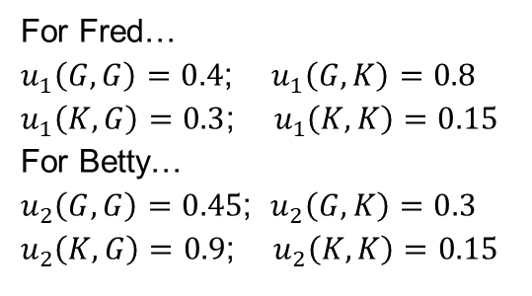

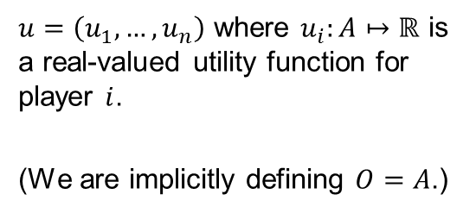

What does every game require? (Let’s formalize the structure)
Component
Formal Definition
Example
Players
$N$ is a finite set of $n$ players, indexed by $i$.
$N=\left\{Fred,Betty\right\}$
Actions
$A=A_{1}×…×A_{n}$, where $A_{i}$ is a finite set of actions available to player $i$. Each vector $a=\left(a_{1},…,a_{n}\right)∈A$ is an action profile.
$A_{1}=\left\{G,K\right\}$ and $A_{2}=\left\{G,K\right\}$, so
$A=\left\{\begin{aligned}\left(G,G\right),\left(G,K\right), \\ \left(K,G\right),(K,K)\end{aligned}\right\}$
consisting of all $2×2=4$ action profiles.
Player preferences over the set of action profiles (a.k.a., utilities for outcomes)
$u=\left(u_{1},…,u_{n}\right)$ where $u_{i}:A↦ℝ$ is a real-valued utility function for player $i$.
(We are implicitly defining $O=A$.)
For Fred…
$u_{1}\left(G,G\right)=0.4$; $u_{1}\left(G,K\right)=0.8$
$u_{1}\left(K,G\right)=0.3$; $u_{1}\left(K,K\right)=0.15$
For Betty…
$u_{2}\left(G,G\right)=0.45$; $u_{2}\left(G,K\right)=0.3$
$u_{2}\left(K,G\right)=0.9$; $u_{2}\left(K,K\right)=0.15$

Slide 3

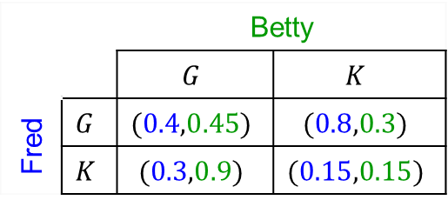
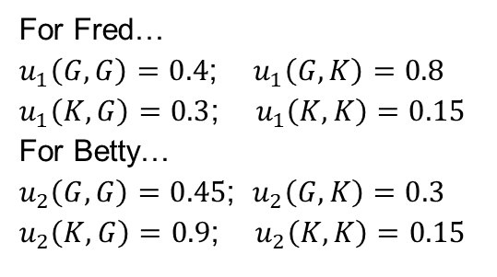
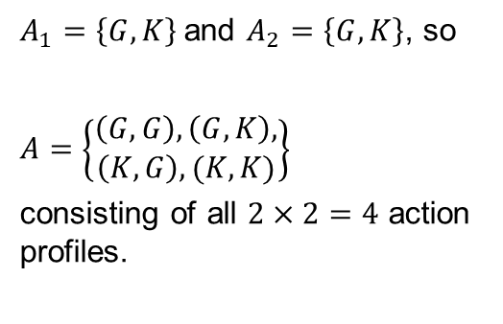
Let’s condense this information
Example
$N=\left\{Fred,Betty\right\}$
$A_{1}=\left\{G,K\right\}$ and $A_{2}=\left\{G,K\right\}$, so
$A=\left\{\begin{aligned}\left(G,G\right),\left(G,K\right), \\ \left(K,G\right),(K,K)\end{aligned}\right\}$
consisting of all $2×2=4$ action profiles.
Tabular Representation
 |  | Betty
 |  | $$G$$ | $$K$$
Fred | $$G$$ | $$(0.4,0.45)$$ | $$(0.8,0.3)$$
 | $$K$$ | $$(0.3,0.9)$$ | $$(0.15,0.15)$$
For Fred…
$u_{1}\left(G,G\right)=0.4$; $u_{1}\left(G,K\right)=0.8$
$u_{1}\left(K,G\right)=0.3$; $u_{1}\left(K,K\right)=0.15$
For Betty…
$u_{2}\left(G,G\right)=0.45$; $u_{2}\left(G,K\right)=0.3$
$u_{2}\left(K,G\right)=0.9$; $u_{2}\left(K,K\right)=0.15$

Slide 4
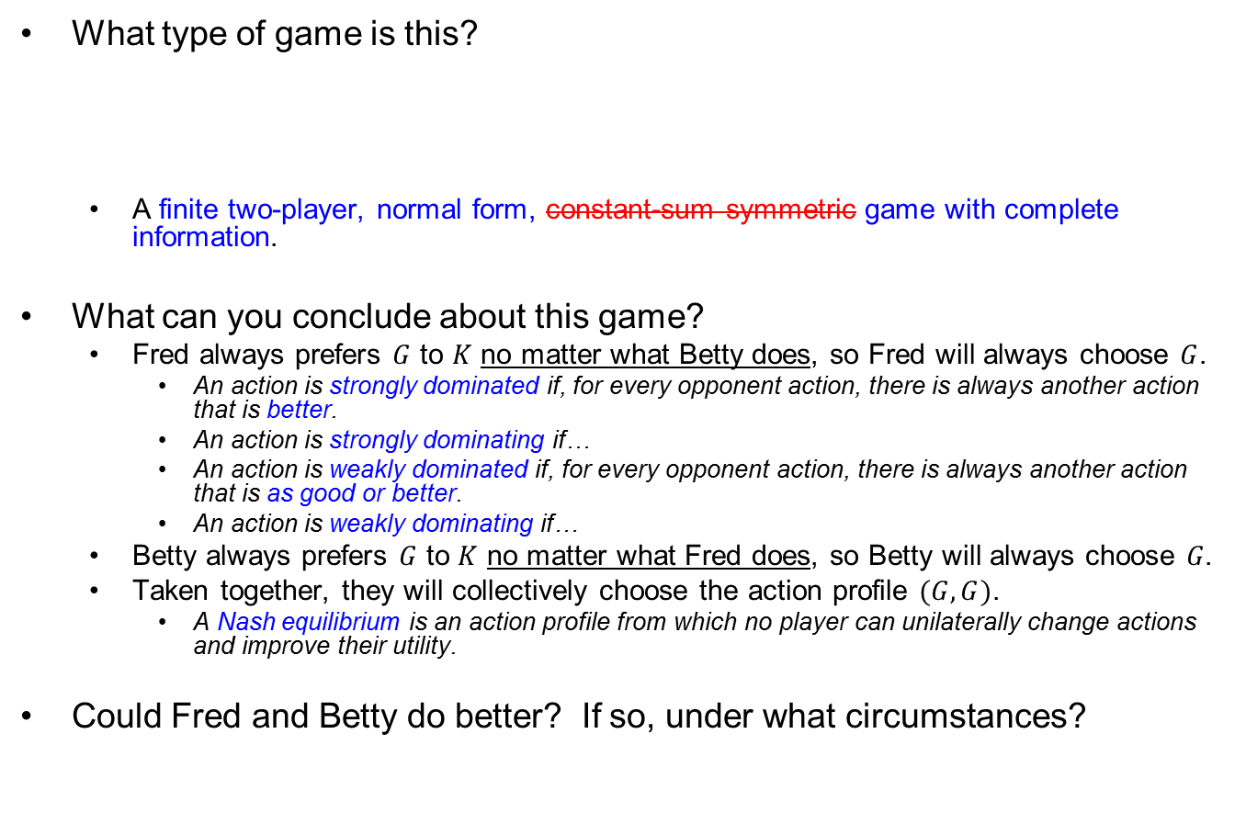
Scenario #1 Discussion
 |  | Betty
 |  | $$G$$ | $$K$$
Fred | $$G$$ | $$(0.4,0.45)$$ | $$(0.8,0.3)$$
 | $$K$$ | $$(0.3,0.9)$$ | $$(0.15,0.15)$$
What type of game is this?
A finite two-player, normal form, constant-sum symmetric game with complete information.
What can you conclude about this game?
Fred always prefers $G$ to $K$ no matter what Betty does, so Fred will always choose $G$.
An action is strongly dominated if, for every opponent action, there is always another action that is better.
An action is strongly dominating if…
An action is weakly dominated if, for every opponent action, there is always another action that is as good or better.
An action is weakly dominating if…
Betty always prefers $G$ to $K$ no matter what Fred does, so Betty will always choose $G\text{.}$
Taken together, they will collectively choose the action profile $(G,G)$.
A Nash equilibrium is an action profile from which no player can unilaterally change actions and improve their utility.
Could Fred and Betty do better? If so, under what circumstances?

Slide 5

John F. Nash, Jr. 1928-2015
American mathematician
1994 Nobel Prize in Economic Sciences for game theory work
2015 Abel Price for work on differential equations
Subject of the 1998 movie “A Beautiful Mind”

Slide 6
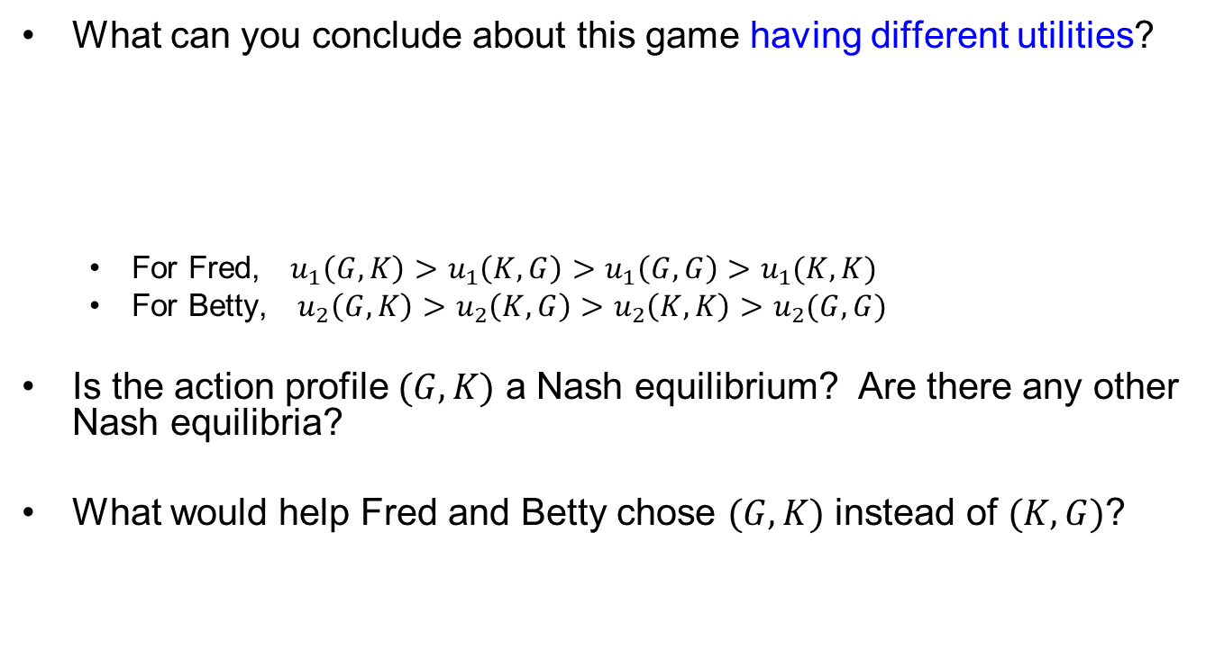
Scenario #2 Discussion
What can you conclude about this game having different utilities?
For Fred, $u_{1}\left(G,K\right)>u_{1}\left(K,G\right)>u_{1}\left(G,G\right)>u_{1}(K,K)$
For Betty, $u_{2}\left(G,K\right)>u_{2}\left(K,G\right)>u_{2}\left(K,K\right)>u_{2}(G,G)$
Is the action profile $(G,K)$ a Nash equilibrium? Are there any other Nash equilibria?
What would help Fred and Betty chose $(G,K)$ instead of $(K,G)$?
 |  | Betty
 |  | $$G$$ | $$K$$
Fred | $$G$$ | $$(0.4,0.3)$$ | $$(0.8,0.9)$$
 | $$K$$ | $$(0.5,0.6)$$ | $$(0.25,0.45)$$

Slide 7
Classic Games

Slide 8
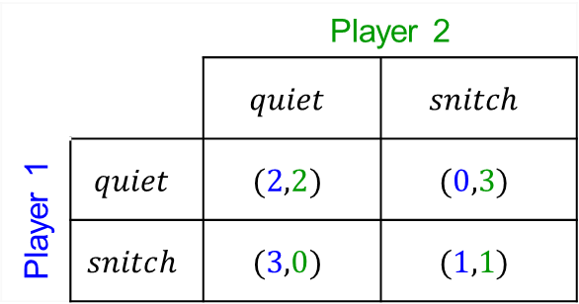
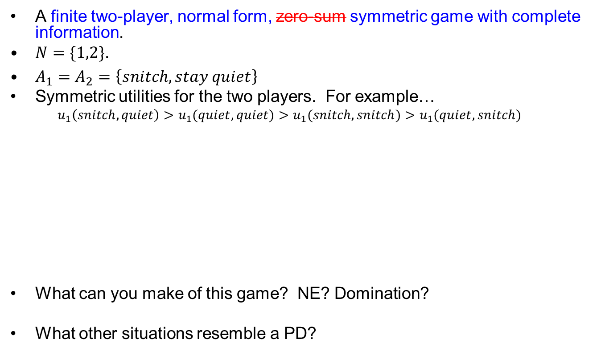
Classic Game #1 Prisoner’s Dilemma (PD)
A finite two-player, normal form, zero-sum symmetric game with complete information.
$N=\{1,2\}$.
$A_{1}=A_{2}=\left\{snitch,stay quiet\right\}$
Symmetric utilities for the two players. For example…
$$u_{1}\left(snitch,quiet\right)>u_{1}(quiet,quiet)>u_{1}(snitch,snitch)>u_{1}(quiet,snitch)$$
What can you make of this game? NE? Domination?
What other situations resemble a PD?
 |  | Player 2
 |  | $$quiet$$ | $$snitch$$
Player 1 | $$quiet$$ | $$(2,2)$$ | $$(0,3)$$
 | $$snitch$$ | $$(3,0)$$ | $$(1,1)$$

Slide 9

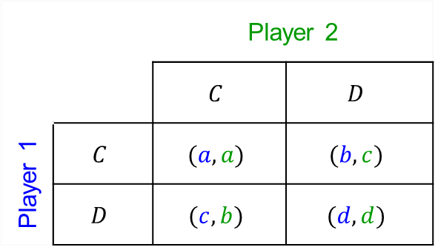
Classic Game #1 Generalized PD
A finite two-player, normal form, zero-sum symmetric game with complete information.
$N=\{1,2\}$ and $A_{1}=A_{2}=\left\{C,D\right\}$
Utility relations must be
$$c>a>d>b$$
 |  | Player 2
 |  | $$C$$ | $$D$$
Player 1 | $$C$$ | $$(a,a)$$ | $$(b,c)$$
 | $$D$$ | $$(c,b)$$ | $$(d,d)$$
Notes:
PD:
Arms race: stockpile (snitch) or reduce (quiet). You are individually better off if you stockpile for an opponent’s action.
Team project: be lazy (snitch) or work hard (quiet). You are both better off if both work hard but individually can improve for an opponent’s action by being lazy.
Doping in athletics: improved performance with risk
Lunch break area: do nothing (snitch) or clean it (quiet). You are all better off if all clean but can have greater utility for an opponent's action if you do nothing.
Environmental emissions: do nothing (snitch) or reduce emissions (quiet).
NFL teams: ignore concussion research (snitch) or apply anti-concussion measures (quiet)

Slide 10
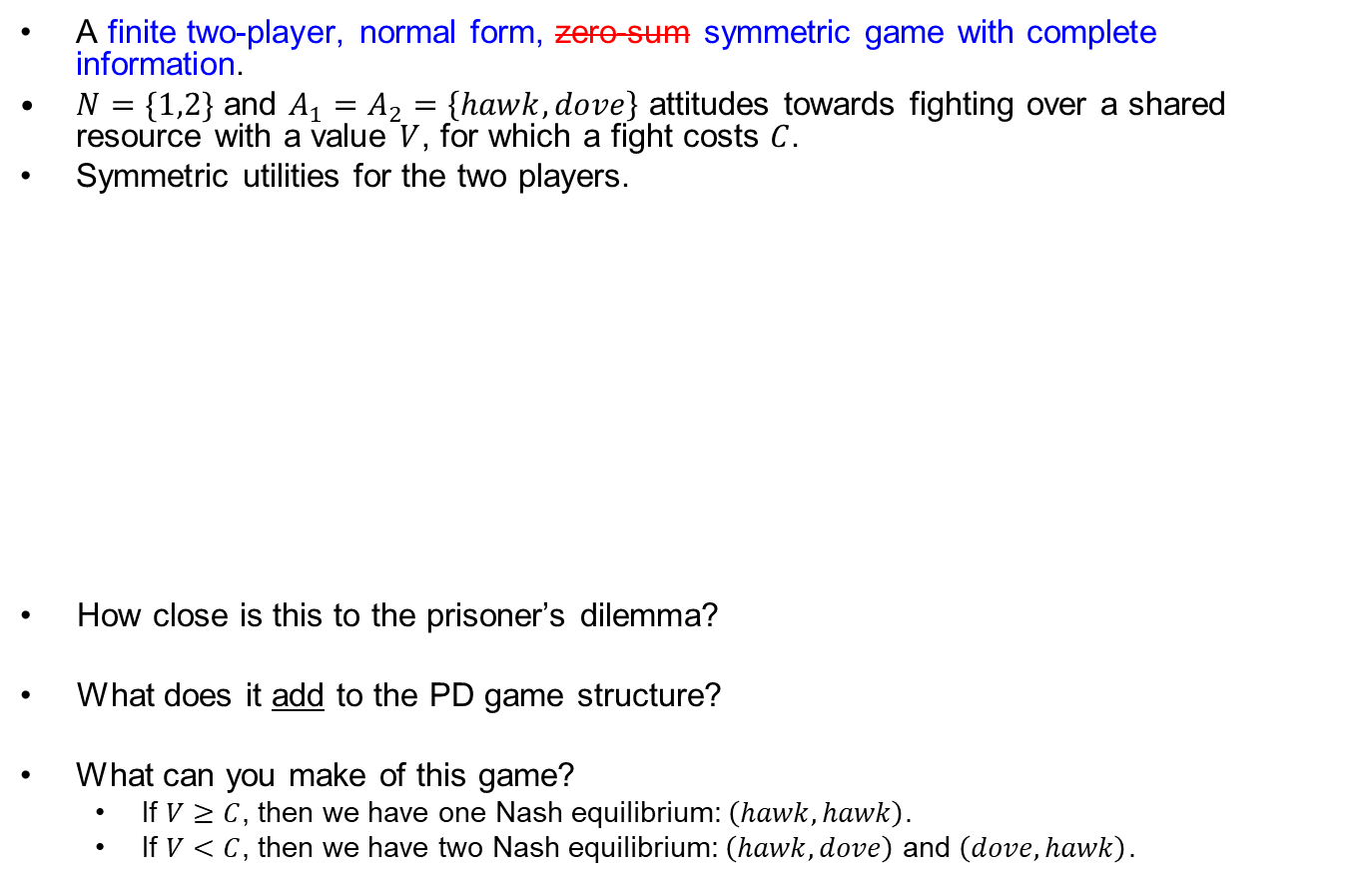
Hawk-Dove Game
A finite two-player, normal form, zero-sum symmetric game with complete information.
$N=\{1,2\}$ and $A_{1}=A_{2}=\left\{hawk,dove\right\}$ attitudes towards fighting over a shared resource with a value $V$, for which a fight costs $C$.
Symmetric utilities for the two players.
How close is this to the prisoner’s dilemma?
What does it add to the PD game structure?
What can you make of this game?
If $V≥C$, then we have one Nash equilibrium: $\left(hawk,hawk\right)$.
If $V<C$, then we have two Nash equilibrium: $\left(hawk,dove\right)$ and $\left(dove,hawk\right)$.
 |  | Player 2
 |  | $$hawk$$ | $$dove$$
Player 1 | $$hawk$$ | $$\left(\frac{V−C}{2},\frac{V−C}{2}\right)$$ | $$(V,0)$$
 | $$dove$$ | $$(0,V)$$ | $$\left(\frac{V}{2},\frac{V}{2}\right)$$

Slide 11
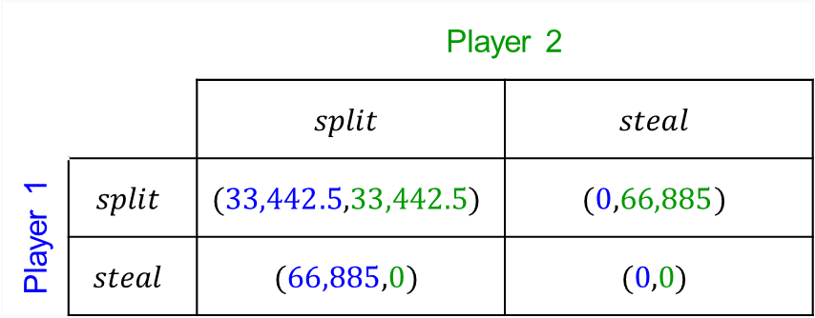
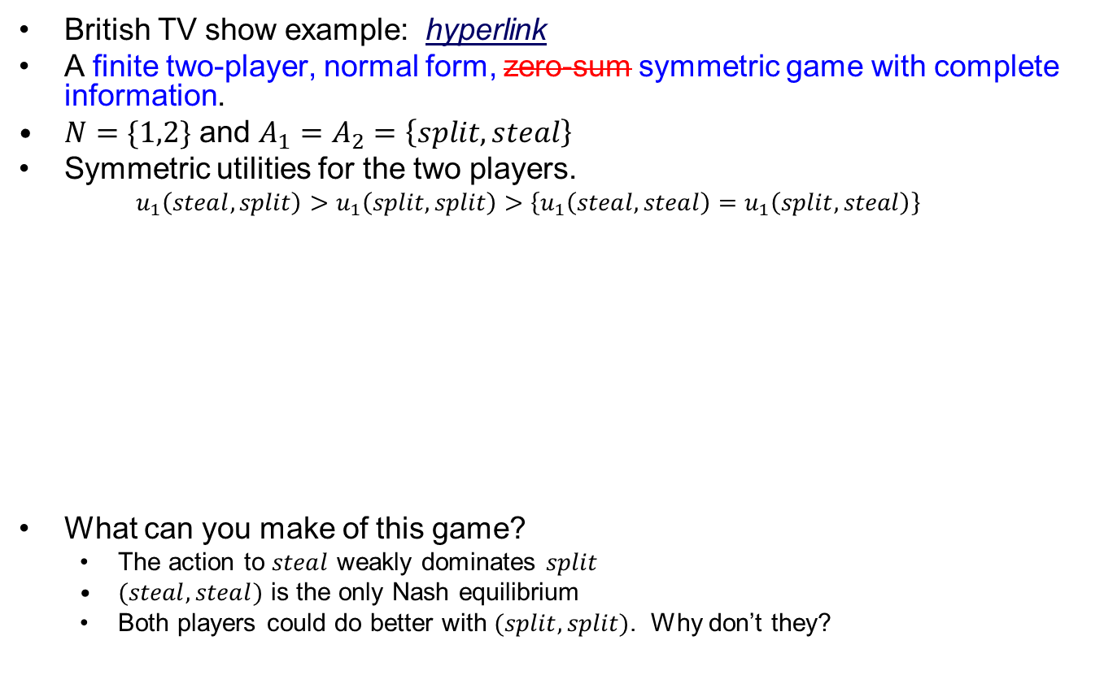
Modified PD
British TV show example: hyperlink
A finite two-player, normal form, zero-sum symmetric game with complete information.
$N=\{1,2\}$ and $A_{1}=A_{2}=\left\{split, steal\right\}$
Symmetric utilities for the two players.
$$u_{1}\left(steal,split\right)>u_{1}\left(split, split\right)>\left\{u_{1}\left(steal,steal\right)=u_{1}\left(split, steal\right)\right\}$$
What can you make of this game?
The action to $steal$ weakly dominates $split$
$(steal,steal)$ is the only Nash equilibrium
Both players could do better with $(split,split)$. Why don’t they?
 |  | Player 2
 |  | $$split$$ | $$steal$$
Player 1 | $$split$$ | $$(33,442.5,33,442.5)$$ | $$(0,66,885)$$
 | $$steal$$ | $$(66,885,0)$$ | $$(0,0)$$

Slide 12

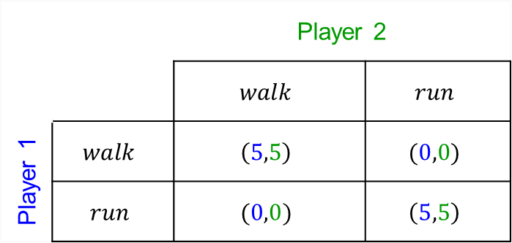
Classic Game #2 Coordination Game
A finite two-player, normal form, zero-sum symmetric game with complete information.
$N=\{1,2\}$ and $A_{1}=A_{2}=\left\{walk dog, run\right\}$ actions to take on a Saturday morning.
Symmetric utilities for the two players.
What are the Nash equilibria?
What does it add to the PD game structure?
 |  | Player 2
 |  | $$walk$$ | $$run$$
Player 1 | $$walk$$ | $$\left(5,5\right)$$ | $$(0,0)$$
 | $$run$$ | $$(0,0)$$ | $$\left(5,5\right)$$

Slide 13
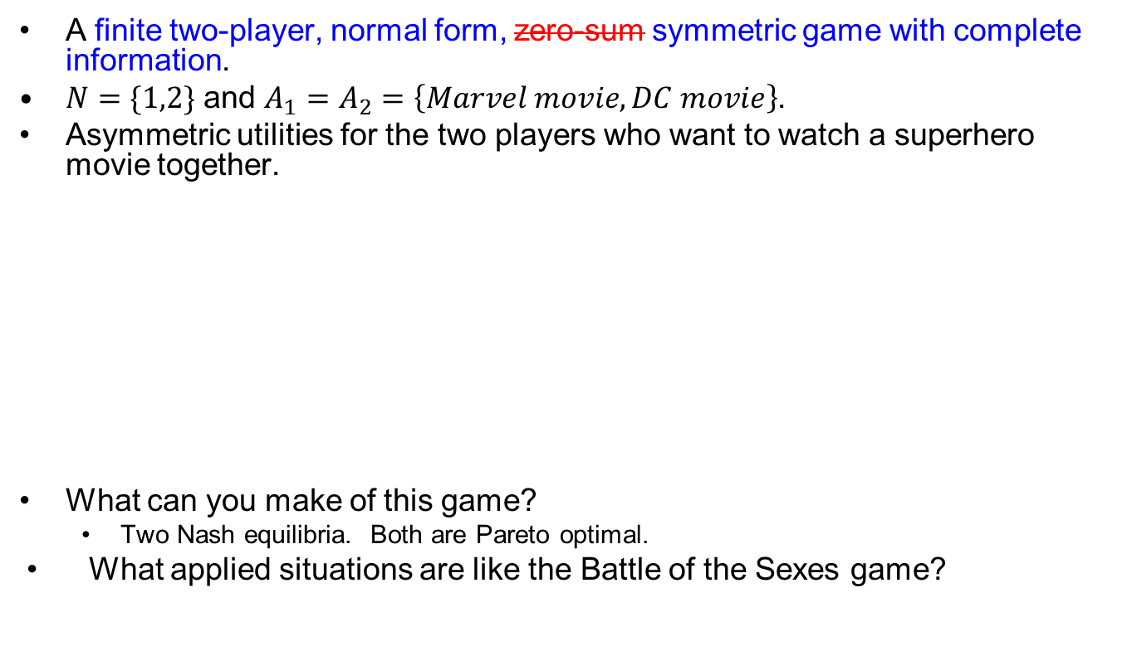
Classic Game #3 Battle of the Sexes (BoS)
A finite two-player, normal form, zero-sum symmetric game with complete information.
$N=\{1,2\}$ and $A_{1}=A_{2}=\left\{Marvel movie,DC movie\right\}$.
Asymmetric utilities for the two players who want to watch a superhero movie together.
What can you make of this game?
Two Nash equilibria. Both are Pareto optimal.
What applied situations are like the Battle of the Sexes game?
 |  | Player 2 DC Fan
 |  | $$Marvel$$ | $$DC$$
Player 1 Marvel Fan | $$Marvel$$ | $$(10,5)$$ | $$(0,0)$$
 | $$DC$$ | $$(0,0)$$ | $$(5,10)$$

Slide 14
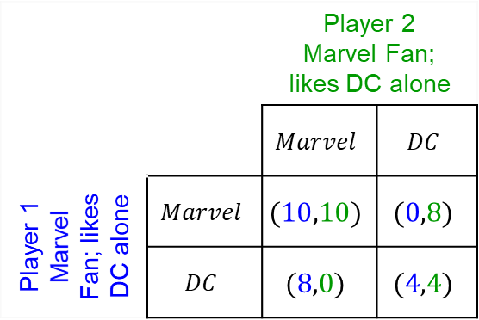
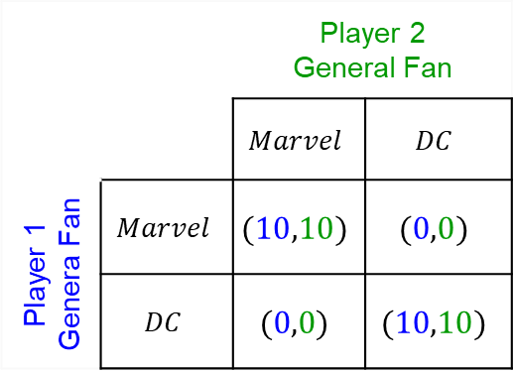
Classic Game #3 Battle of the Sexes Variants
What happens with different utilities for the outcomes?
 |  | Player 2 DC Fan
 |  | $$Marvel$$ | $$DC$$
Player 1 Marvel Fan | $$Marvel$$ | $$(10,5)$$ | $$(0,0)$$
 | $$DC$$ | $$(0,0)$$ | $$(5,10)$$
 |  | Player 2 Marvel Fan
 |  | $$Marvel$$ | $$DC$$
Player 1 Marvel Fan | $$Marvel$$ | $$(10,10)$$ | $$(0,0)$$
 | $$DC$$ | $$(0,0)$$ | $$(5,5)$$
2 Nash equilibria
2 Pareto optimal action profiles
2 Nash equilibria
Strong preference of 1 NE for both players
 |  | Player 2 Marvel Fan; likes DC alone
 |  | $$Marvel$$ | $$DC$$
Player 1 Marvel Fan; likes DC alone | $$Marvel$$ | $$(10,10)$$ | $$(0,8)$$
 | $$DC$$ | $$(8,0)$$ | $$(4,4)$$
 |  | Player 2 General Fan
 |  | $$Marvel$$ | $$DC$$
Player 1 Genera Fan | $$Marvel$$ | $$(10,10)$$ | $$(0,0)$$
 | $$DC$$ | $$(0,0)$$ | $$(10,10)$$
2 Nash equilibria; strong preference
(a.k.a., “Stag hunt” game)
2 Nash equilibria; No preference between them → Coordination Game

Slide 15
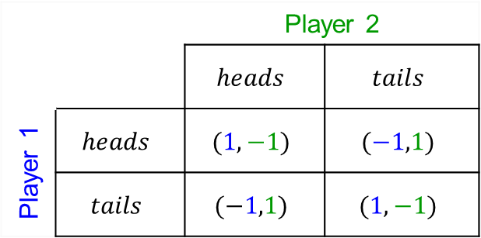
Classic Game #4 Matching Pennies (MP)
A finite two-player, normal form, zero-sum symmetric game with complete information.
$N=\{1,2\}$ and $A_{1}=A_{2}=\left\{heads,tails\right\}$
If they match, Player 1 gets both; if they differ, Player 2 wins them both.
What can you make of this game?
No Nash equilibria among these action profiles.
May as well flip the coin…
Similar to rock-paper-scissors… and rock-paper-scissors-lizard-Spock.
 |  | Player 2
 |  | $$heads$$ | $$tails$$
Player 1 | $$heads$$ | $$(1,−1)$$ | $$(−1,1)$$
 | $$tails$$ | $$(−1,1)$$ | $$(1,−1)$$

Slide 16
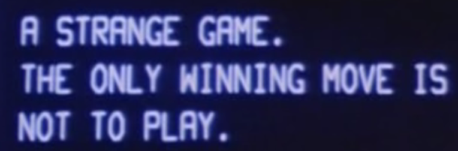
Chicken
A finite two-player, normal form, zero-sum symmetric game with complete information.
$N=\{1,2\}$.
$A_{1}=A_{2}=\left\{swerve,drive straight\right\}$
Symmetric utilities for the two players.
$$u_{1}\left(straight,swerve\right)>u_{1}(swerve,swerve)>u_{1}(swerve,straight)>u_{1}(straight,straight)$$
What can you make of this game?
$(swerve,straight)$ and $(straight,swerve)$ are the two Nash equilibria
They are also Pareto optimal → A Pareto optimal action profile is one for which there exists no alternative that yields an equal or better outcome for every player.
As “Joshua” would say…
What applied situations are like the chicken game?
Engaging in open conflict that is inherently self-destructive (nukes, conventional, cyber, etc.)
 |  | Player 2
 |  | $$swerve$$ | $$straight$$
Player 1 | $$swerve$$ | $$(0,0)$$ | $$(−1,1)$$
 | $$straight$$ | $$(1,−1)$$ | $$(−10,−10)$$

Slide 17
Revisiting Assumptions
Or, as Monty Python would say,
“What if he’s got a pointed stick?”*
* Self-defense Against Fresh Fruit

Slide 18
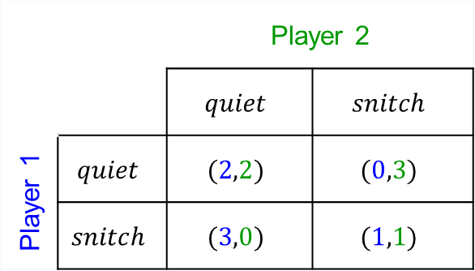
Classic Game #1 Prisoner’s Dilemma (PD)
Nothing new on this slide; it’s just a refresher
A finite two-player, normal form, zero-sum symmetric game with complete information.
$N=\{1,2\}$.
$A_{1}=A_{2}=\left\{snitch,stay quiet\right\}$
Symmetric utilities for the two players.
$$u_{1}\left(snitch,quiet\right)>u_{1}(quiet,quiet)>u_{1}(snitch,snitch)>u_{1}(quiet,snitch)$$
What can you make of this game?
$(snitch,snitch)$ is the only Nash equilibrium
Both players could do better with $(quiet,quiet)$. Why don’t they?
 |  | Player 2
 |  | $$quiet$$ | $$snitch$$
Player 1 | $$quiet$$ | $$(2,2)$$ | $$(0,3)$$
 | $$snitch$$ | $$(3,0)$$ | $$(1,1)$$

Slide 19
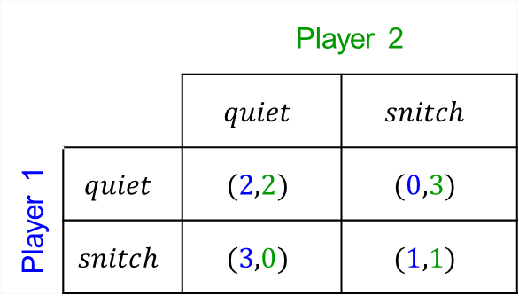
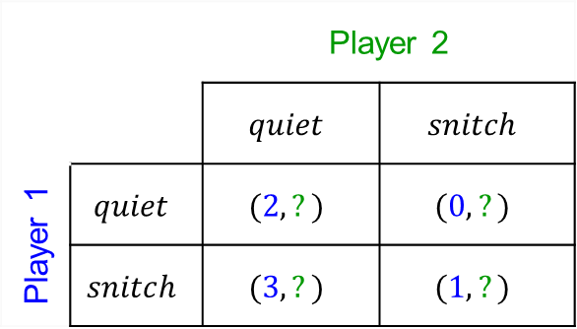
Prisoner’s Dilemma What if it’s not complete?
Let’s consider an example in which only Player 1’s utilities are known.
A finite two-player, normal form, zero-sum symmetric game with complete information.
What will Player 1 do? Why?
The readings for Lesson 03 will address some options
 |  | Player 2
 |  | $$quiet$$ | $$snitch$$
Player 1 | $$quiet$$ | $$(2,2)$$ | $$(0,3)$$
 | $$snitch$$ | $$(3,0)$$ | $$(1,1)$$
 |  | Player 2
 |  | $$quiet$$ | $$snitch$$
Player 1 | $$quiet$$ | $$(2,?)$$ | $$(0,?)$$
 | $$snitch$$ | $$(3,?)$$ | $$(1,?)$$

Slide 20
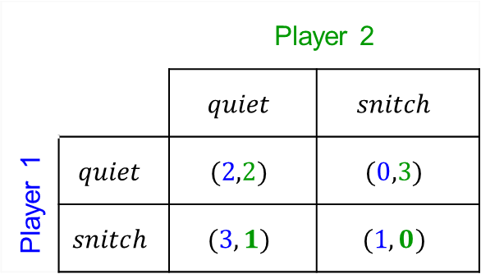
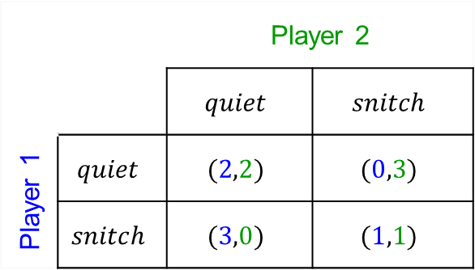

Prisoner’s Dilemma What if it’s not symmetric?
A finite two-player, normal form, zero-sum symmetric game with complete information.
$N=\{1,2\}$ and $A_{1}=A_{2}=\left\{snitch,stay quiet\right\}$
Asymmetric utilities for the players. (Player 2 doesn’t want to go to prison as a snitch!)
$$u_{1}\left(snitch,quiet\right)>u_{1}(quiet,quiet)>u_{1}(snitch,snitch)>u_{1}\left(quiet,snitch\right)$$
$$u_{2}(quiet,snitch)>u_{2}(quiet,quiet)>u_{2}\left(snitch,quiet\right)>u_{2}(snitch,snitch)$$
What happened to our game?
 |  | Player 2
 |  | $$quiet$$ | $$snitch$$
Player 1 | $$quiet$$ | $$(2,2)$$ | $$(0,3)$$
 | $$snitch$$ | $$(3,0)$$ | $$(1,1)$$
 |  | Player 2
 |  | $$quiet$$ | $$snitch$$
Player 1 | $$quiet$$ | $$(2,2)$$ | $$(0,3)$$
 | $$snitch$$ | $$(3,1)$$ | $$(1,0)$$

Slide 21

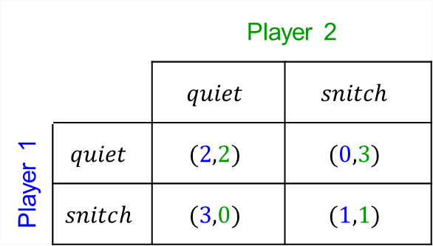









Prisoner’s Dilemma What if it’s not normal form?
A finite two-player, extensive form, zero-sum symmetric game with complete and perfect information.
$N=\{1,2\}$ and $A_{1}=A_{2}=\left\{snitch,stay quiet\right\}$
One player goes first. The other player observes the choice and then takes a turn.
Symmetric utilities for the two players.
$$u_{1}\left(snitch,quiet\right)>u_{1}(quiet,quiet)>u_{1}(snitch,snitch)>u_{1}(quiet,snitch)$$
1
 |  | Player 2
 |  | $$quiet$$ | $$snitch$$
Player 1 | $$quiet$$ | $$(2,2)$$ | $$(0,3)$$
 | $$snitch$$ | $$(3,0)$$ | $$(1,1)$$
$$quiet$$
$$snitch$$
2
2
$$quiet$$
$$snitch$$
$$quiet$$
$$snitch$$
$$(2,2)$$
$$(0,3)$$
$$(3,0)$$
$$(1,1)$$
We’ll cover more on extensive form games later in the course.

Slide 22
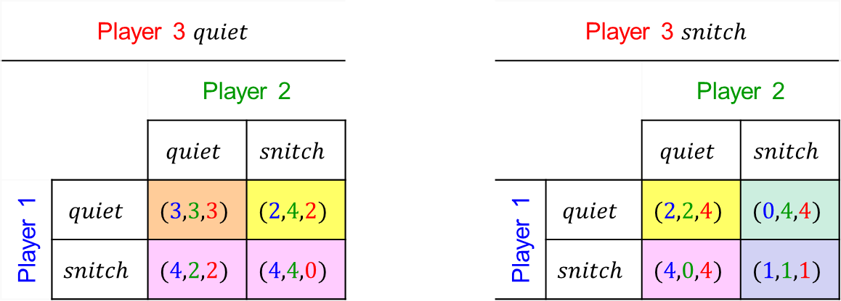
Prisoner’s Dilemma What if it’s not two players?
A finite three-player, normal form, zero-sum symmetric game with complete information.
$N=\{1,2,3\}$ and $A_{1}=A_{2}=A_{3}=\left\{snitch,stay quiet\right\}$
Symmetric utilities for the three players.
Outcome rankings for Player #1
$$\left\{u_{1}\left(s,q,q\right),u_{1}\left(s,s,q\right),u_{1}\left(s,q,s\right)\right\}>u_{1}\left(q,q,q\right)>\left\{u_{1}\left(q,s,q\right),u_{i}\left(q,q,s\right)\right\}>u_{1}\left(s,s,s\right)>u_{1}\left(q,s,s\right)$$
Snitch and someone else doesn’t
All quiet
Quiet; 1 other snitches
All snitch
“Take the rap”
Player 3 $quiet$ |  |  |  |  | Player 3 $snitch$
 |  | Player 2 |  |  |  |  | Player 2
 |  | $$quiet$$ | $$snitch$$ |  |  |  | $$quiet$$ | $$snitch$$
Player 1 | $$quiet$$ | $$(3,3,3)$$ | $$(2,4,2)$$ |  | Player 1 | $$quiet$$ | $$(2,2,4)$$ | $$(0,4,4)$$
 | $$snitch$$ | $$(4,2,2)$$ | $$(4,4,0)$$ |  |  | $$snitch$$ | $$(4,0,4)$$ | $$(1,1,1)$$
(You can also visualize this as a cube, but it’s harder to show the utilities in the respective boxes.)

Slide 23
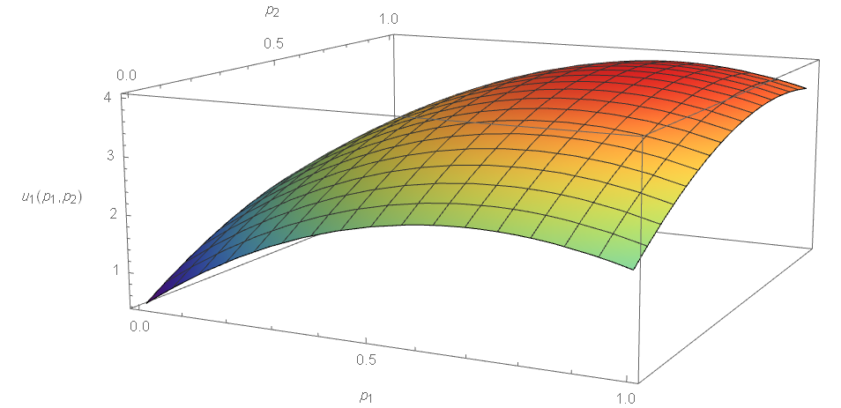

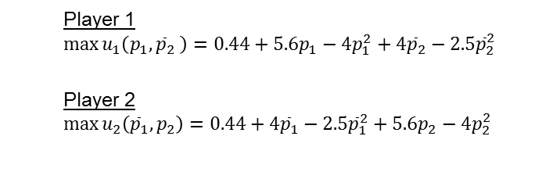
Prisoner’s Dilemma What if it’s not finite?
A finite two-player, normal form, zero-sum symmetric game with complete information.
$N=\{1,2\}$ and $A_{i}=\left\{0≤p_{i}≤1\right\}$ where $p_{i}$ is the percentage of information to withhold from the interrogator.
Symmetric utilities for the two players. Player #1’s utility function might be:
$u_{1}\left(p_{1},{\overline{p}}_{2}\right)=0.44+5.6p_{1}−4p_{1}^{2}+4{\overline{p}}_{2}−2.5{\overline{p}}_{2}^{2}$for a given value of ${\overline{p}}_{2}$
How do you solve a game like this?
For this example, differential calculus and a bit of linear algebra would work!
How could we derive such a utility function? (notional function shown)
 |  | Player 2
 |  | $$snitch$$ | $$quiet$$
Player 1 | $$snitch$$ | $$(1,1)$$ | $$(3,0)$$
 | $$quiet$$ | $$(0,3)$$ | $$(2,2)$$
Player 1
$$\max{u_{1}\left(p_{1},{\overline{p}}_{2} \right)=0.44+5.6p_{1}−4p_{1}^{2}+4{\overline{p}}_{2}−2.5{\overline{p}}_{2}^{2}}$$
Player 2
$$\max{u_{2}\left({\overline{p}}_{1},p_{2}\right)=0.44+4{\overline{p}}_{1}−2.5{\overline{p}}_{1}^{2}+5.6p_{2}−4p_{2}^{2}}$$

Slide 24
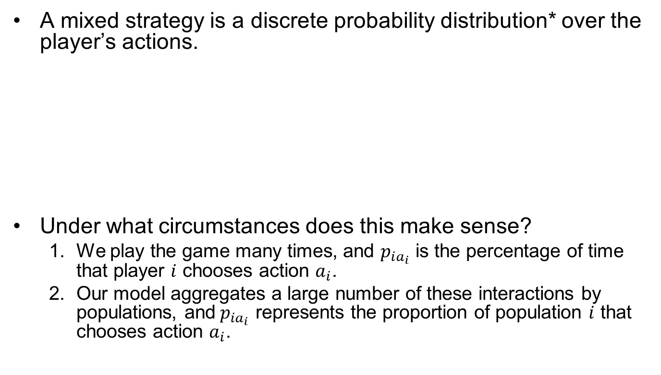
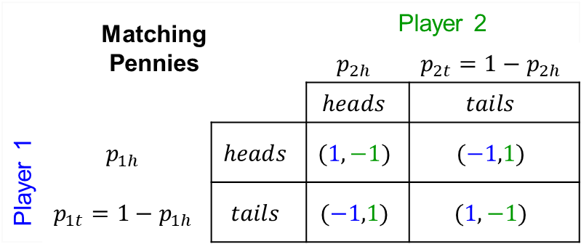
Mixed Strategies
A mixed strategy is a discrete probability distribution* over the player’s actions.
Under what circumstances does this make sense?
We play the game many times, and $p_{ia_{i}}$ is the percentage of time that player $i$ chooses action $a_{i}$.
Our model aggregates a large number of these interactions by populations, and$p_{ia_{i}}$ represents the proportion of population $i$ that chooses action $a_{i}$.
Matching Pennies |  |  | Player 2
 |  |  | $$p_{2h}$$ | $$p_{2t}=1−p_{2h}$$
 |  |  | $$heads$$ | $$tails$$
Player 1 | $$p_{1h}$$ | $$heads$$ | $$(1,−1)$$ | $$(−1,1)$$
 | $$p_{1t}=1−p_{1h}$$ | $$tails$$ | $$(−1,1)$$ | $$(1,−1)$$
* A discrete probability distribution is a set of probabilities for actions that sum to a value of one.

Slide 25
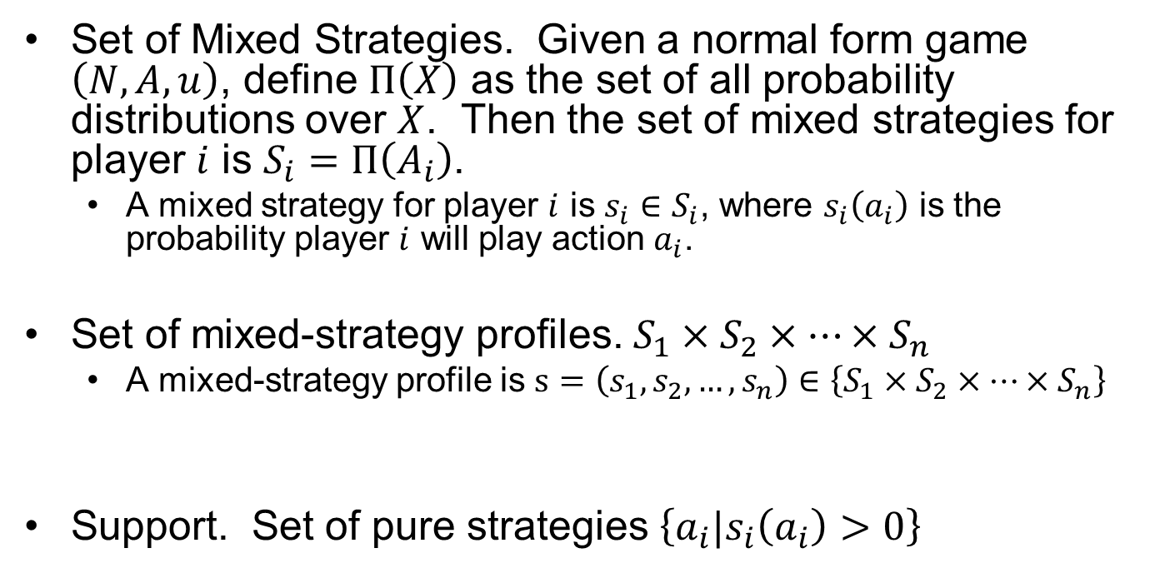
Mixed Strategies (A More General Representation)
Set of Mixed Strategies. Given a normal form game $\left(N,A,u\right)$, define $Π\left(X\right)$ as the set of all probability distributions over $X$. Then the set of mixed strategies for player $i$ is $S_{i}=Π\left(A_{i}\right)$.
A mixed strategy for player $i$ is $s_{i}∈S_{i}$, where $s_{i}\left(a_{i}\right)$ is the probability player $i$ will play action $a_{i}$.
Set of mixed-strategy profiles. $S_{1}×S_{2}×…×S_{n}$
A mixed-strategy profile is $s=\left(s_{1},s_{2},…,s_{n}\right)∈\left\{S_{1}×S_{2}×…×S_{n}\right\}$
Support. Set of pure strategies $\left\{a_{i}|s_{i}\left(a_{i}\right)>0\right\}$

Slide 26
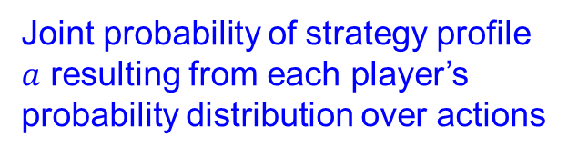
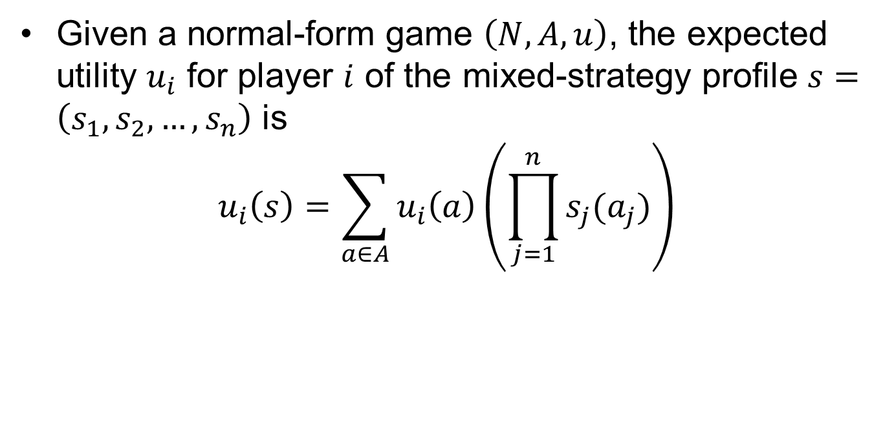


Expected Utility
Given a normal-form game $\left(N,A,u\right)$, the expected utility $u_{i}$ for player $i$ of the mixed-strategy profile $s=\left(s_{1},s_{2},…,s_{n}\right)$ is
$$u_{i}\left(s\right)=\sum_{a∈A}{u_{i}\left(a\right)\left(\prod_{j=1}^{n}{s_{j}(a_{j})}\right)}$$
Utility of strategy profile $a$
Joint probability of strategy profile $a$ resulting from each player’s probability distribution over actions
Considering all strategy profiles $a∈A$

Slide 27
Questions & Discussion

